Slide 1
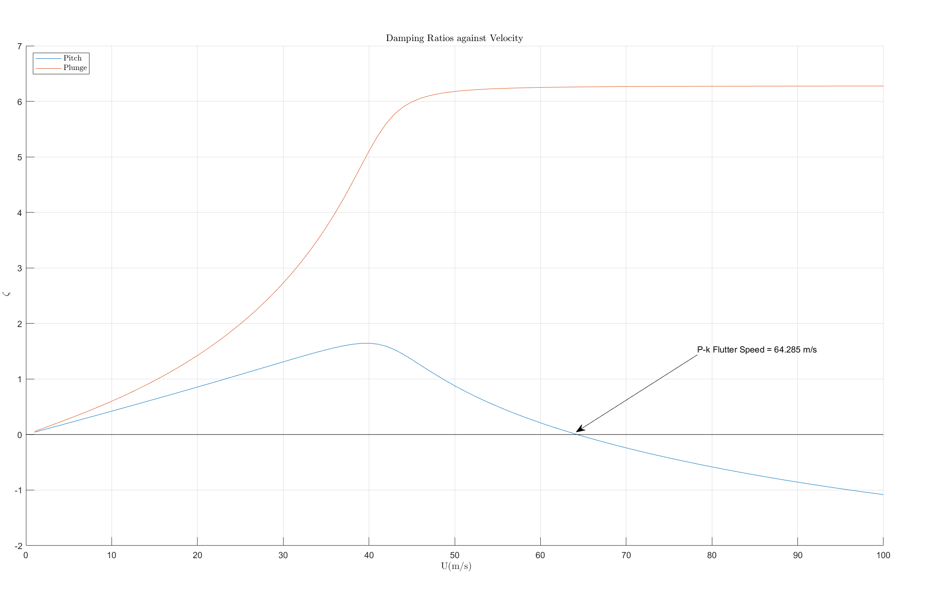
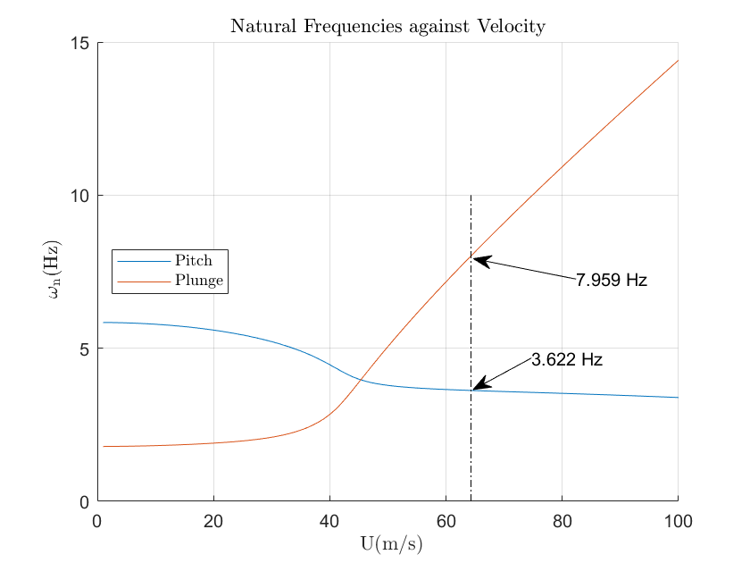
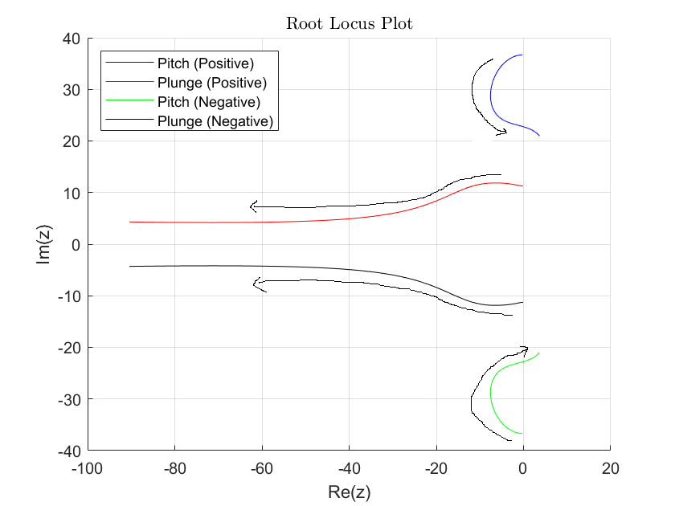
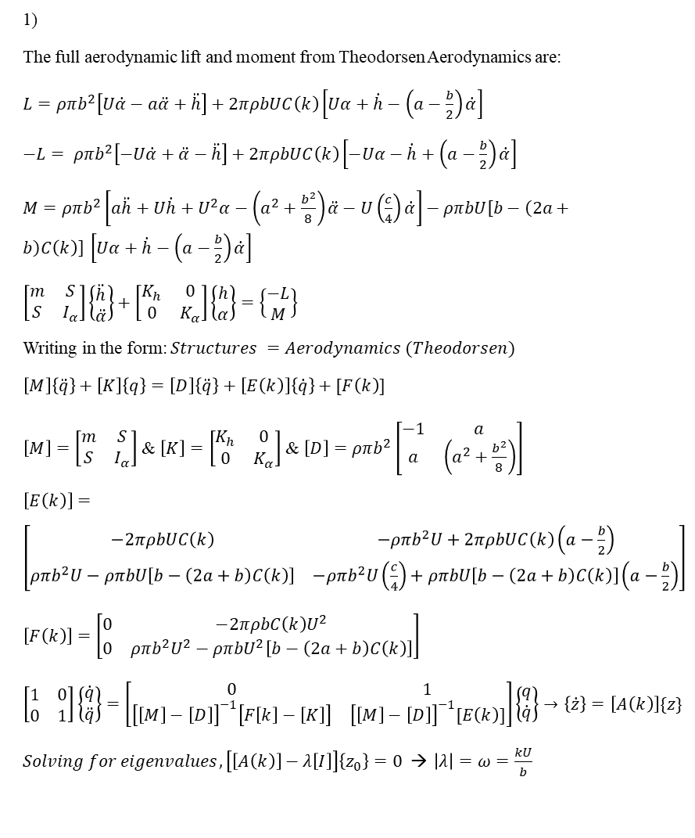
MA4704 Aeroelasticity – CA4 Seah Yong Le Stanley U2121954F
Terms:
$μ_{airfoil}=800 kg/m^{3}$; $ρ=1.225 kg/m^{3}$; $c=2 m$; $x_{f}=0.45c$; $t=0.01m$; $l=3 m$; $ω_{h}=2 Hz$; $ω_{α}=6 Hz$; $a=−0.05c$; $b=c/2$; $mass=μtc$; $K_{h}=mω_{h}^{2}$; $I_{α}=\frac{mc^{2}}{12}+ma^{2}$; $K_{α}=I_{α}ω_{α}^{2}$ ; $S=−ma$
1)
The full aerodynamic lift and moment from Theodorsen Aerodynamics are:
$L=ρπb^{2}\left[U\dot{α}−a\ddot{α}+\ddot{h}\right]+2πρbUC\left(k\right)\left[Uα+\dot{h}−\left(a−\frac{b}{2}\right)\dot{α}\right]$
$−L= ρπb^{2}\left[−U\dot{α}+\ddot{α}−\ddot{h}\right]+2πρbUC\left(k\right)\left[−Uα−\dot{h}+\left(a−\frac{b}{2}\right)\dot{α}\right]$
$M=ρπb^{2}\left[a\ddot{h}+U\dot{h}+U^{2}α−\left(a^{2}+\frac{b^{2}}{8}\right)\ddot{α}−U\left(\frac{c}{4}\right)\dot{α}\right]−ρπbU\left[b−\left(2a+b\right)C\left(k\right)\right] \left[Uα+\dot{h}−\left(a−\frac{b}{2}\right)\dot{α}\right]$
$\left[\begin{matrix}m & S \\ S & I_{α}\end{matrix}\right]\left\{\begin{matrix}\ddot{h} \\ \ddot{α}\end{matrix}\right\}+\left[\begin{matrix}K_{h} & 0 \\ 0 & K_{α}\end{matrix}\right]\left\{\begin{matrix}h \\ α\end{matrix}\right\}=\left\{\begin{matrix}−L \\ M\end{matrix}\right\}$
Writing in the form: $Structures =Aerodynamics (Theodorsen)$
$\left[M\right]\left\{\ddot{q}\right\}+\left[K\right]\left\{q\right\}=\left[D\right]\left\{\ddot{q}\right\}+\left[E\left(k\right)\right]\left\{\dot{q}\right\}+[F\left(k\right)]$
$\left[M\right]=\left[\begin{matrix}m & S \\ S & I_{α}\end{matrix}\right]$ & $\left[K\right]=\left[\begin{matrix}K_{h} & 0 \\ 0 & K_{α}\end{matrix}\right]$ & $\left[D\right]=ρπb^{2}\left[\begin{matrix}−1 & a \\ a & \left(a^{2}+\frac{b^{2}}{8}\right)\end{matrix}\right]$
$\left[E\left(k\right)\right]=\left[\begin{matrix}−2πρbUC\left(k\right) & −ρπb^{2}U+2πρbUC\left(k\right)\left(a−\frac{b}{2}\right) \\ ρπb^{2}U−ρπbU\left[b−\left(2a+b\right)C\left(k\right)\right] & −ρπb^{2}U\left(\frac{c}{4}\right)+ρπbU\left[b−\left(2a+b\right)C\left(k\right)\right]\left(a−\frac{b}{2}\right)\end{matrix}\right]$
$\left[F\left(k\right)\right]=\left[\begin{matrix}0 & −2πρbC\left(k\right)U^{2} \\ 0 & ρπb^{2}U^{2}−ρπbU^{2}\left[b−\left(2a+b\right)C\left(k\right)\right]\end{matrix}\right]$
$\left[\begin{matrix}1 & 0 \\ 0 & 1\end{matrix}\right]\left\{\begin{matrix}\dot{q} \\ \ddot{q}\end{matrix}\right\}=\left[\begin{matrix}0 & 1 \\ {\left[\left[M\right]−\left[D\right]\right]}^{−1}\left[F\left[k\right]−\left[K\right]\right] & {\left[\left[M\right]−\left[D\right]\right]}^{−1}[E\left(k\right)]\end{matrix}\right]\left\{\begin{matrix}q \\ \dot{q}\end{matrix}\right\}$ $→\left\{\dot{z}\right\}=\left[A\left(k\right)\right]\{z\}$
$Solving for eigenvalues, \left[\left[A\left(k\right)\right]−λ\left[I\right]\right]\left\{z_{0}\right\}=0$ → $\left|λ\right|=ω=\frac{kU}{b}$
2)
The flutter speed obtained from the P-k Method via the intersection between the pitch curve and the x – axis is 64.285 m/s, with a corresponding plunge natural frequency of 7.96 Hz and a Pitch Natural Frequency of 3.622 Hz.
Damping Ratio VS Velocity Graph
As the airspeed increases, the plunge damping ratio increases rapidly, whereas the pitch damping ratio decreases rapidly after hitting a peak at 40 m/s , meaning a high stability for plunge but a declining stability for pitch.
Natural Frequency VS Velocity
As velocity increases, the natural frequency plots for pitch and plunge start to converge. When the two plots converge, and intersect each other at around 45 m/s, modes for pitch and plunge are becoming coupled, signifying the onset of flutter, where the wing becomes more unstable until the flutter speed (64.285 m/s), where the oscillations become o unstable it results in catastrophic failure.
3)
Plotting the Root Locus Plot for Frequency of airspeeds from 1 – 100 m/s as well as the complex conjugates, and the directions of the plots are drawn as followed. Looking at the plots, the pitch modes are relatively stable initially, but as speed increases, the plot crosses past the y-axis at x = 0, meaning at high speeds, pitch becomes more and more unstable past a certain point. On the other hand, as speed increases, the modes for plunge moves more to the left, meaning it becomes more stable at higher speeds.

Slide 2
clear
% Define Key Terms
rho = 1.225; % Air Density
mu = 800; % Density of Airfoil
c = 2;
x_f = 0.45*c; % Location of Elastic Axis from LE
a = -0.05*c;
b = c/2;
thickness = 0.01; % thickness m
L = 3; % length m
mass = mu*thickness*c; % mass kg
omega_h = 2*2*pi; % plunge (rad/s)
omega_alpha = 6*2*pi; % pitch (rad/s)
K_h = mass*((omega_h)^2);
I_alpha = (mass*(c^2))/12 + mass*(a^2);
K_alpha = (I_alpha)*(omega_alpha^2); % pitch stiffness
S = -mass*a ;
% Define Matrix
M = [mass S; S I_alpha];
K = [K_h 0;0 K_alpha];
D = rho*pi*b^2*[-1 a;a -(a^2)-((b^2)/8)];
m_d = M - D;
first_try = [sqrt(K_h/mass) ; sqrt(K_alpha/I_alpha)]; % Initial guess for omega and k
epsilon = 10E-5 ; % degree of error allowed
% Setting up the velocity
vel = linspace(1,100,100);
freq = zeros(2,100);
for i = 1:100 % Iterate airspeed from 1 to 100
for j = 1:2 % Degree of Freedom, j = 1 is plunge, j = 2 is pitch
omega = first_try(j); % first try
error = 1;
while error > epsilon
init_guess = omega;
k=init_guess * b/ vel(i);
C = 1 - 0.165/(1-(0.0455/k)*1i) - 0.335/(1-(0.30/k)*1i);
% Define E
E_1 = -2*pi*rho*b*vel(i)*C;
E_2 = -rho*pi*b^2*vel(i) + 2*pi*rho*b*vel(i)*C*(a-b/2);
E_3 = rho*pi*b^2*vel(i) - rho*pi*b*vel(i)*(b-((2*a)+b)*C);
E_4 = -rho*pi*b^2*vel(i)*c/4 + rho*pi*b*vel(i)*(b-((2*a)+b)*C)*(a-b/2);
E = [E_1 E_2;E_3 E_4];
% Define F
F_2 = -2*pi*rho*b*(vel(i)^2)*C;
F_4 = rho*pi*b^2*(vel(i)^2) - rho*pi*b*vel(i)^2*(b-((2*a)+b)*C);
F = [0 F_2;0 F_4];
F_K = F - K;
A = [zeros(2,2) eye(2); m_d\F_K m_d\E]; % 4x4
[~, A2]=eig(A);
A2 = diag(A2);
[sorted,index]=sort(imag(A2),"descend");
omega = sorted(j);
error = abs(init_guess-omega);
freq(j,i) = A2(index(j)); % continuously updates Frequency
end
if error < epsilon
error = 1; % reset the value of tol once while condition is reached
end
end
end
freq_pk = abs(freq)/2/pi;
damp_pk = -real(freq) ./ freq_pk ;
% Plot Damping Ratios
figure
grid on
hold on
plot_1 = plot(vel,damp_pk(1,:));
plot_2 = plot(vel,damp_pk(2,:));
Vel_plot = plot([0 100], [0 0],'k');
xlim([0 100])
xlabel('$ ~\mathrm{U (m/s)}$', 'interpreter','latex', "FontSize",11);
ylabel('$ ~\mathrm{\zeta}$', 'interpreter','latex', "FontSize",11);
legend([plot_1 plot_2], {'Pitch','Plunge'},'interpreter','latex', "Location","northwest");
title("Damping Ratios against Velocity",'Interpreter',"latex","FontSize",11)
annotation('textarrow',[0.736904761904762 0.627380952380952],[0.421222222222222 0.295238095238095],'String',{'P-k Flutter Speed = 64.285 m/s'},'FontSize', 10);
hold off
% Plot Frequency Ratios
figure
grid on
hold on
plot_3 = plot(vel,freq_pk(1,:));
plot_4 = plot(vel,freq_pk(2,:));
flut_speed = plot([64.285 64.285], [0 10], 'LineStyle',"-.",'Color','black');
xlim([0 100])
xlabel('$ ~\mathrm{U (m/s)}$', 'interpreter','latex', "FontSize",11);
ylabel('$ ~\mathrm{\omega_n (Hz)}$', 'interpreter','latex', "FontSize",11);
legend([plot_3 plot_4], {'Pitch','Plunge'},'interpreter','latex', "Location","west");
title("Natural Frequencies against Velocity",'Interpreter',"latex","FontSize",11)
% Create textarrow
annotation('textarrow',[0.70859375 0.630859375],...
[0.364045806906272 0.307963354474982],'String',{'3.622 Hz'});
annotation('textarrow',[0.76796875 0.63125],...
[0.504285412262157 0.540521494009866],'String',{'7.959 Hz'});
hold off
% Plot Root Locus
figure
grid on
hold on
plot_5 = plot(real(freq(1, :)),imag(freq(1, :) ), 'b', 'DisplayName', 'Pitch (Positive)');
plot_6 = plot(real(freq(2, :)), imag(freq(2, :)), 'r', 'DisplayName', 'Plunge (Positive)');
plot_7 = plot(real(freq(1, :)),-1*imag(freq(1, :) ), 'g', 'DisplayName', 'Pitch (Negative)');
plot_8 = plot(real(freq(2, :)),-1*imag(freq(2, :)), 'k', 'DisplayName', 'Plunge (Negative)');
xlabel('Re(z)', 'FontSize', 11);
ylabel('Im(z)', 'FontSize', 11);
legend('Location', 'northwest');
title('Root Locus Plot', 'Interpreter', 'latex', 'FontSize', 11);
hold off

